Slide 1

Airbnb NYC: What Drives the Price of a Listing?
A multiple regression analysis of 1,042 New York City listings
BUS 312 · Spring 2026 | Shahmeer · Arely · Shawkot · Andrew · Alexandra
Presenter Shahmeer Shaikh

Slide 2

The Project & Data
Can we predict the nightly price of an NYC Airbnb listing from its observable features?
1,042
18
Clean Listings
Variables Collected
After removing outliers and dropping rows with missing values
Including price, beds, baths, room type, borough, availability & reviews
5
2025
NYC Boroughs
Data Year
Manhattan, Brooklyn, Queens, Bronx, and Staten Island
Collected from Inside Airbnb, March 2025
Data cleansing completed prior to analysis: prices capped at $450 to remove extreme outliers; rows with missing values in key variables were dropped.
Presenter Shahmeer Shaikh

Slide 3
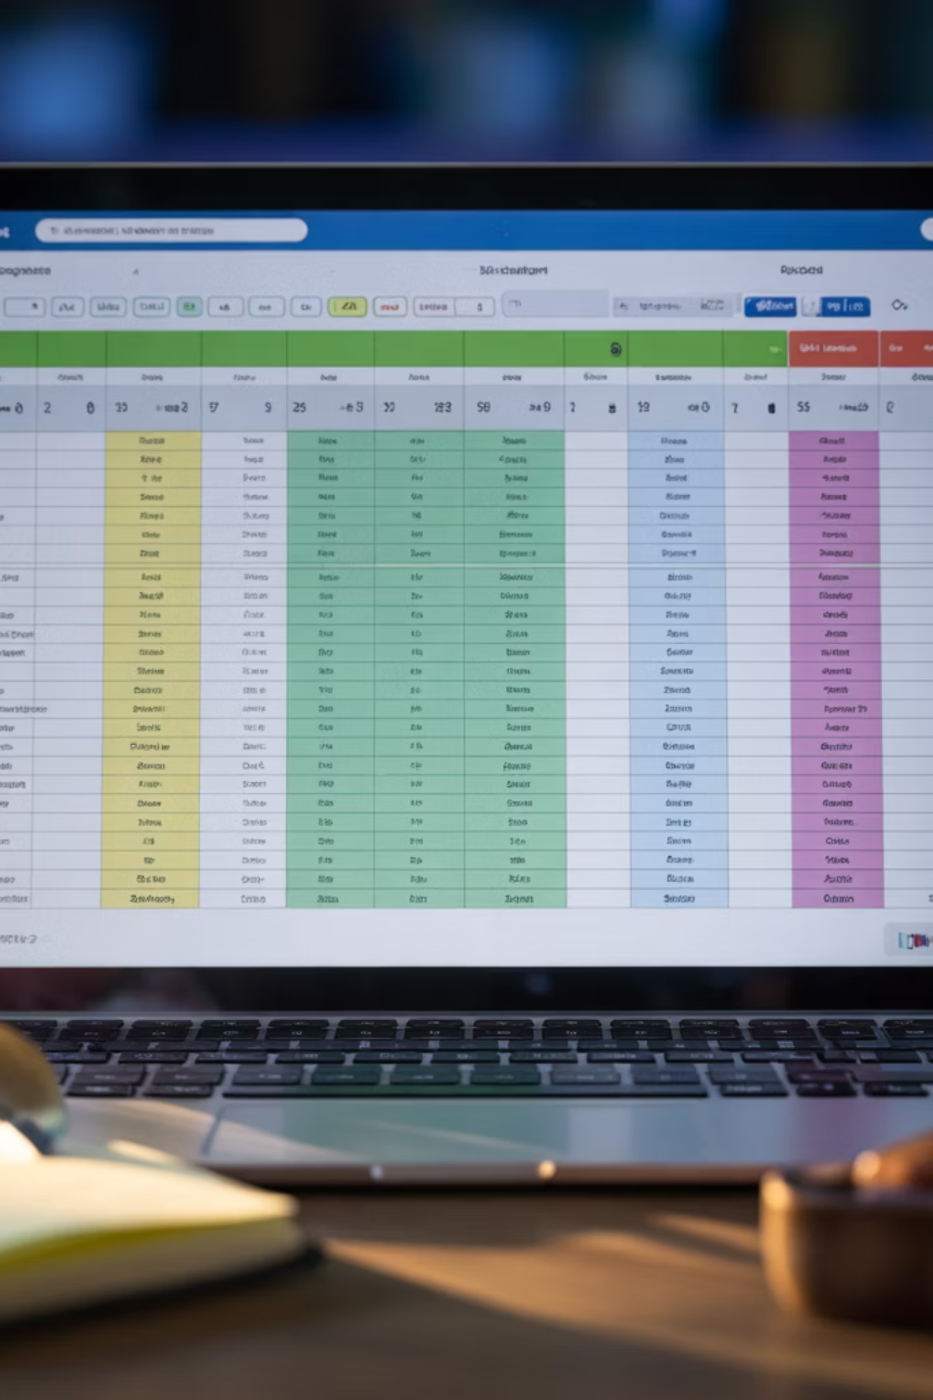

Data Cleansing
From raw Airbnb export to a clean, analysis-ready dataset.
Standardize Columns
1
Cleaned Borough and Room Type labels; unified number formats so text fields worked as proper categorical variables.
Handle Outliers & Gaps
2
Capped prices at $450 to remove extreme outliers; dropped rows with missing values in key variables.
Add Estimated Price
3
Built a calculated Estimated Price column to compare model predictions against actual listing prices.
Final dataset: 1,042 clean listings · 18 variables · 5 NYC boroughs · ready for regression.
Presenter Shahmeer Shaikh

Slide 4
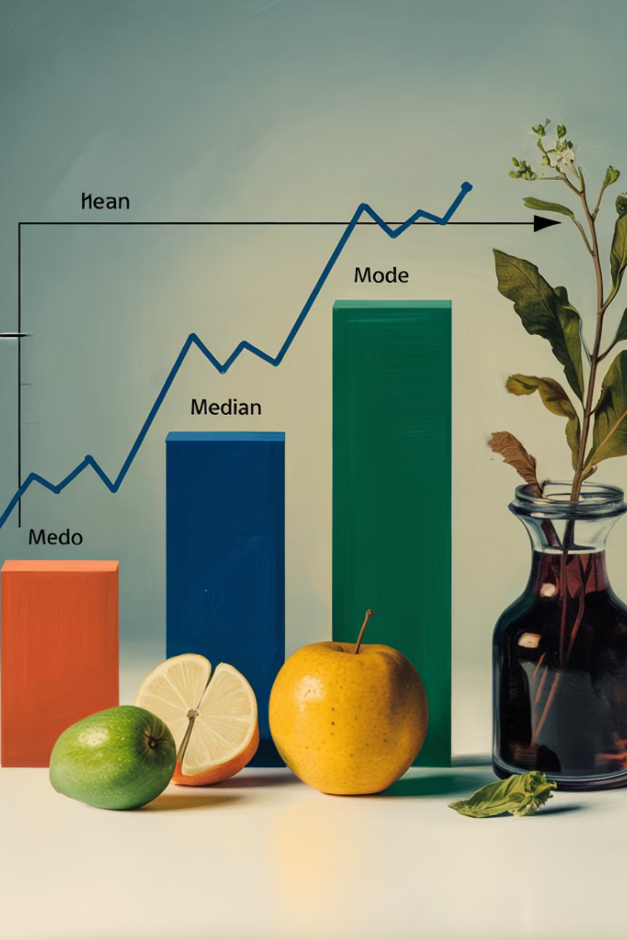
Descriptive Statistics
The typical NYC listing: $134 a night, modest and right-skewed.
$158.71
$134
Avg Price by Borough
Mean Nightly Price
Weighted average across all five boroughs
Central tendency of the sample distribution
$120
$87.95
Median
Std. Deviation
Half of listings fall below this price point
Reflects meaningful price spread across the dataset
1.13
Skewness
Right-skewed: a long upper tail of premium listings pulls the mean above the median
Source: Sample of 1,042 NYC listings, Inside Airbnb / class dataset, March 2025. Price range: $50–$450.
Presenter Shahmeer Shaikh

Slide 5
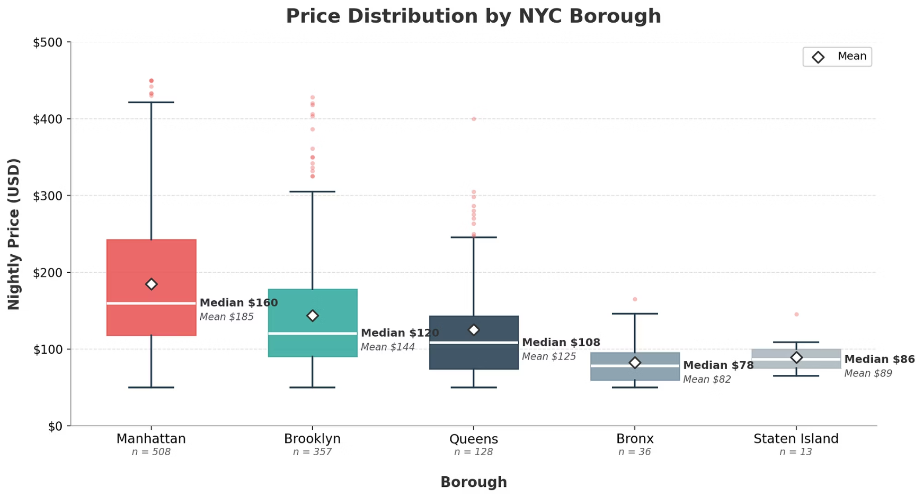
Price by Neighborhood Group
Manhattan commands the premium — and the widest price spread.
Key Takeaways
Box = IQR (25th–75th percentile). White line = median. Diamond = mean. Dots = outliers.
Manhattan Leads
Brooklyn in the Middle
Outer Boroughs Cluster Low
Median $160, with listings reaching $420+ at the top whisker — the most expensive and variable borough.
Median $120 — roughly $40 cheaper than Manhattan, with moderate spread.
Bronx & Staten Island medians sit below $90, with tight price ranges and few outliers.
Presenter Shahmeer Shaikh

Slide 6
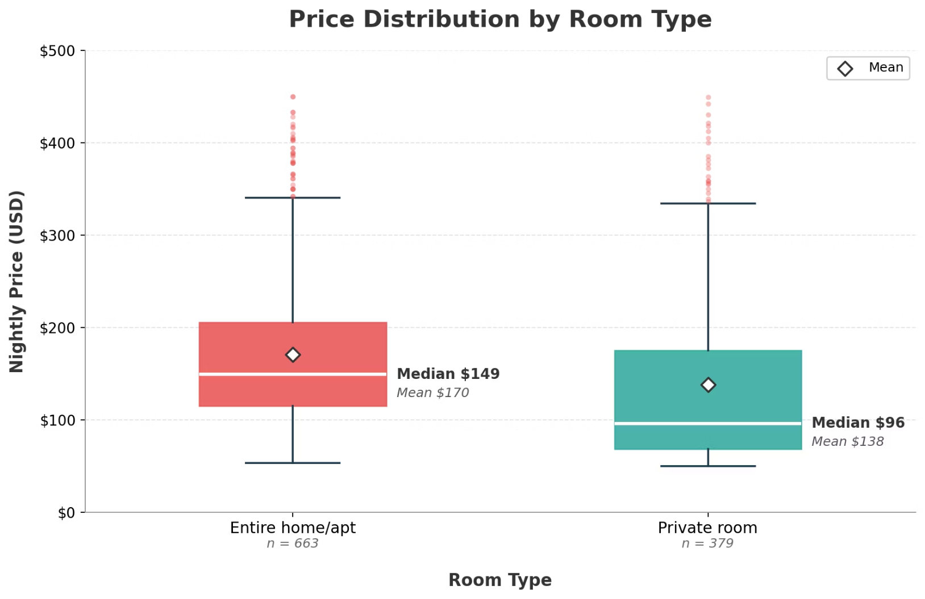

Price by Room Type
Entire homes rent for about $53 more per night at the median — and this gap becomes one of our strongest regression signals.
What to Notice
Entire Home/Apt: $149 Median
Higher median and a wider IQR — reflecting larger, more flexible listings with greater price variability.
Private Room: $96 Median
Consistently cheaper, with a narrower core price range and a mean of $138.
Room type is a meaningful price driver — it becomes one of our strongest regression predictors (coefficient: −$43.30).
Presenter Shahmeer Shaikh

Slide 7

What Correlates With Price?
Accommodates and minimum nights stand out. Reviews, surprisingly, don't move the needle.
1
Capacity Is King
Accommodates shows the strongest positive correlation (+0.45). Bigger units that sleep more guests command higher nightly prices.
2
Minimum Nights Pushes Price Down
A correlation of −0.41 — listings requiring longer minimum stays are associated with lower nightly rates, likely reflecting a discount-for-commitment pattern.
3
Reviews Are Noise
Number of reviews and review frequency show weak or near-zero correlation with price — guest engagement doesn't reliably signal listing value.
Pearson correlation coefficients between each variable and nightly price (n = 1,042).
Presenter Shahmeer Shaikh

Slide 8
Regression Model — All NYC
Six predictors explain roughly 47% of the variation in nightly price. The model is highly significant overall (F = 152.0, p < 0.001).
0.468
152.0
1,042
R²
F-Statistic
Observations
Variance in price explained by the model
p < 0.001 — model is highly significant
Full cleaned dataset used in regression
Variable
Coefficient
t Stat
p-value
Interpretation
Accommodates
+18.99
13.16
< 0.001
+$19 per additional guest
Borough
+15.24
11.20
< 0.001
Price rises moving toward Manhattan
Bathrooms
+11.22
2.58
0.010
+$11 per extra bathroom
Room Type
−43.30
−8.47
< 0.001
Private rooms ≈ $43 cheaper
Minimum Nights
−3.35
−18.19
< 0.001
−$3.35 per extra required night
Availability 365
−0.04
−2.15
0.032
Tiny effect, barely significant
Intercept = $155.12. All six predictors significant at α = 0.05.
Presenter Shahmeer Shaikh

Slide 9
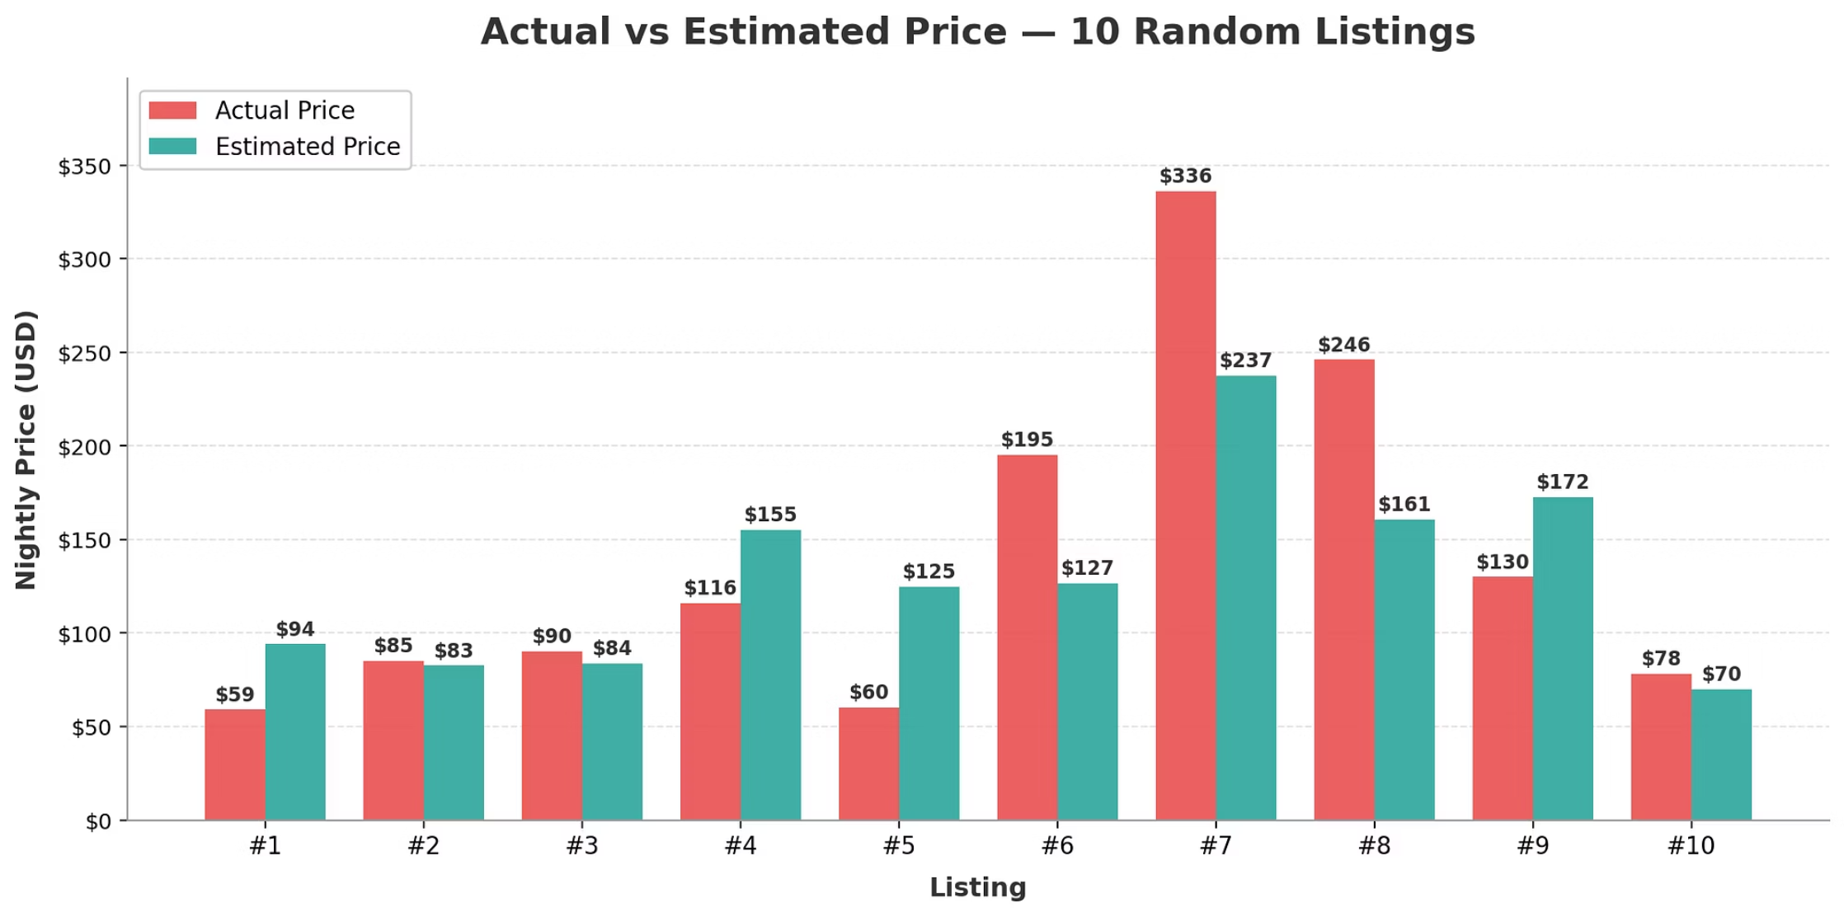

Actual vs. Estimated Price
Testing our model on 10 randomly selected listings — predictions track closely for low- and mid-range listings.
All NYC Model
Manhattan-Only Model
Adjusted R² = 0.465
Adjusted R² = 0.475
n = 1,042 · 6 predictors
n = 508 · 9 predictors
Unit size and amenities explain slightly more variation once location is held constant.
The model underestimates the most expensive listings (#7, #8) and overshoots a few low-end ones (#1, #4, #5) — a common pattern when price extremes are driven by unobserved factors like luxury amenities or unique locations.
Presenter Shahmeer Shaikh

Slide 10
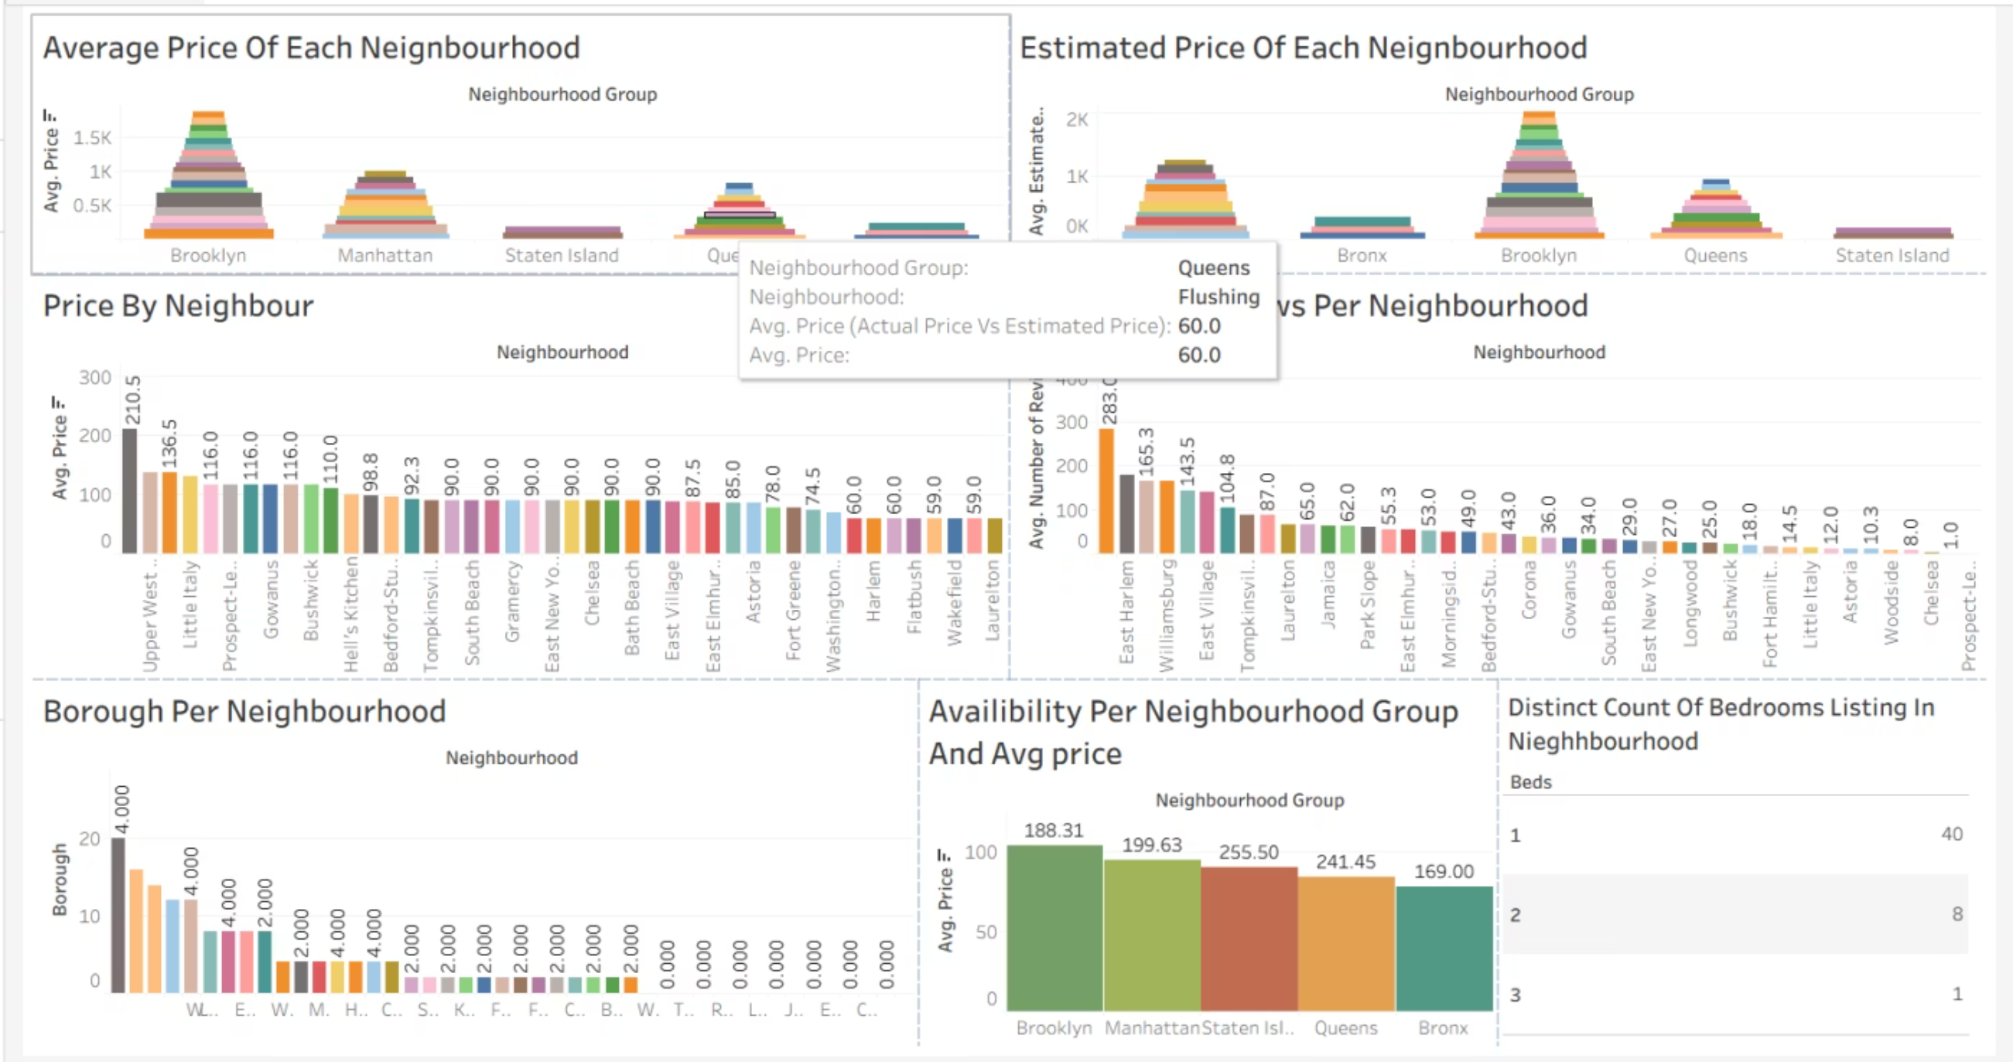
Visualization Summary
Tableau dashboard and Pearson correlation matrix — two complementary views that motivate and contextualize the regression model.
Tableau Dashboard
Average and estimated prices broken out by borough and neighborhood, plus listing counts. Brooklyn and Manhattan dominate by volume and price; Bronx and Staten Island trail in both dimensions.
Presenter Shahmeer Shaikh

Slide 11
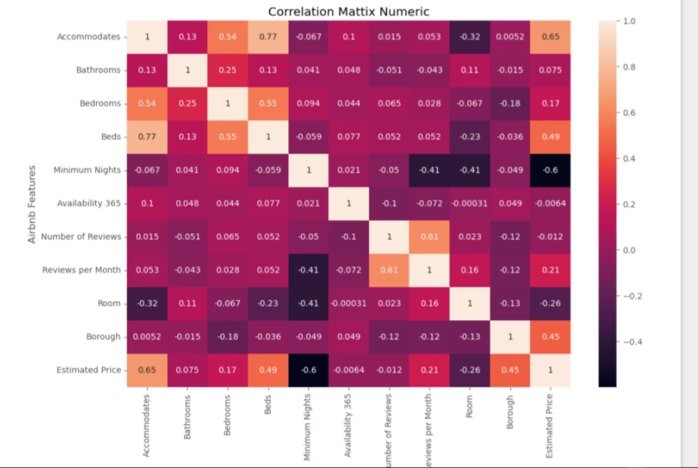
Correlation Matrix
Pearson correlations across all numeric features. Accommodates (+0.65) and borough (+0.45) correlate most strongly with price; minimum nights (−0.60) is the standout negative driver.
Presenter Shahmeer Shaikh

Slide 12
CONCLUSION
What the Data Tells Us
Size and location drive price
Private rooms discount = $43
Model is useful, not perfect
Accommodates (+$19/guest) and borough (+$15.24) are the strongest predictors. A listing's capacity and where it sits in NYC matter most.
Holding other factors constant, private rooms rent for about $43 less per night than entire homes — a meaningful market segmentation.
The regression explains 47% of price variation. Unobserved factors like luxury amenities, unique locations, and guest reviews fill the remaining gap.
Presenter Shahmeer Shaikh

